Slide 1
Watershedleadership Wiki
Anna Burke, Adam Rickert,
Matthew Newell

Slide 2
Problem: WLA course knowledge not disseminated to full potential
Opportunity: Provide an option for homework assignments to be developed as a wiki. Upon graduation, each student will have a rich online body of work that can be shared and matured with:
Community
Employers
Other Watershed Experts

Slide 3
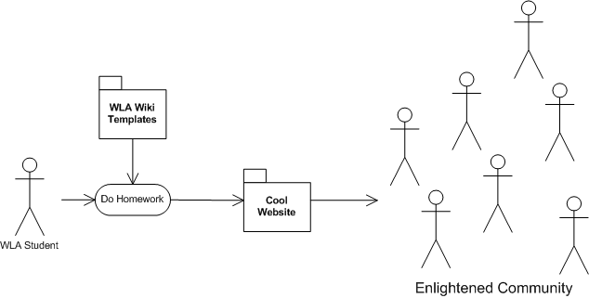
The Concept

Slide 4
Benefits
Graduates leave with an online body of work
Easier to complete class assignments
Easier to disseminate and review information
Develops web skills
Message amplification:
Data is reachable via search engines
30 students/yr X 5 years = 150 watershed web sites

Slide 5
Project Scope
Proof of concept for review by WLA Administration. If interested, transition and follow-up efforts required.
Proposed Structure
Watershedleadership.wikispaces.com
Administrator account
Sets templates for homework assignments
Username.wikispaces.com
Uses templates to create class assignments

Slide 6
Examples
Module R4: Watershed Inventory Observation
Module R5 and R6: Land use planning & Logic Models
Elective Modules:
A5: Drainage Policy
B5: BMPs
C4: Estimating and Presenting Environmental and Economic Benefits

